Slide 1

CART from A to B
James Guszcza, FCAS, MAAA
CAS Predictive Modeling Seminar
Chicago
September, 2005
Notes:
Copyright 2003 -- Confidential and Proprietary -- Deloitte & Touche LLP

Slide 2
Contents
An Insurance Example
Some Basic Theory
Suggested Uses of CART
Case Study: comparing CART with other methods
Notes:
Copyright 2003 -- Confidential and Proprietary -- Deloitte & Touche LLP

Slide 3
What is CART?
Classification And Regression Trees
Developed by Breiman, Friedman, Olshen, Stone in early 80’s.
  Introduced tree-based modeling into the statistical mainstream
  Rigorous approach involving cross-validation to select the optimal tree
One of many tree-based modeling techniques.
  CART -- the classic
  CHAID
  C5.0
  Software package variants (SAS, S-Plus, R…)
  Note: the “rpart” package in “R” is freely available
Notes:
Copyright 2003 -- Confidential and Proprietary -- Deloitte & Touche LLP

Slide 4
Philosophy
“Our philosophy in data analysis is to look at the data from a number of different viewpoints. Tree structured regression offers an interesting alternative for looking at regression type problems. It has sometimes given clues to data structure not apparent from a linear regression analysis. Like any tool, its greatest benefit lies in its intelligent and sensible application.” --Breiman, Friedman, Olshen, Stone
Notes:
Copyright 2003 -- Confidential and Proprietary -- Deloitte & Touche LLP

Slide 5
The Key Idea
Recursive Partitioning
Take all of your data.
Consider all possible values of all variables.
Select the variable/value (X=t₁) that produces the greatest “separation” in the target.
    (X=t₁) is called a “split”.
If X< t₁ then send the data to the “left”; otherwise, send data point to the “right”.
Now repeat same process on these two “nodes”
    You get a “tree”
    Note: CART only uses binary splits.
Notes:
Copyright 2003 -- Confidential and Proprietary -- Deloitte & Touche LLP

Slide 6
An Insurance Example
Notes:
Copyright 2003 -- Confidential and Proprietary -- Deloitte & Touche LLP

Slide 7
Let’s Get Rolling
Suppose you have 3 variables:
    # vehicles: {1,2,3…10⁺}
    Age category: {1,2,3…6}
    Liability-only: {0,1}
At each iteration, CART tests all 15 splits.
    (#veh<2), (#veh<3),…, (#veh<10)
    (age<2),…, (age<6)
    (lia<1)
Select split resulting in greatest increase in purity.
  Perfect purity: each split has either all claims or all no-claims.
  Perfect impurity: each split has same proportion of claims as overall population.
Notes:
Copyright 2003 -- Confidential and Proprietary -- Deloitte & Touche LLP

Slide 8
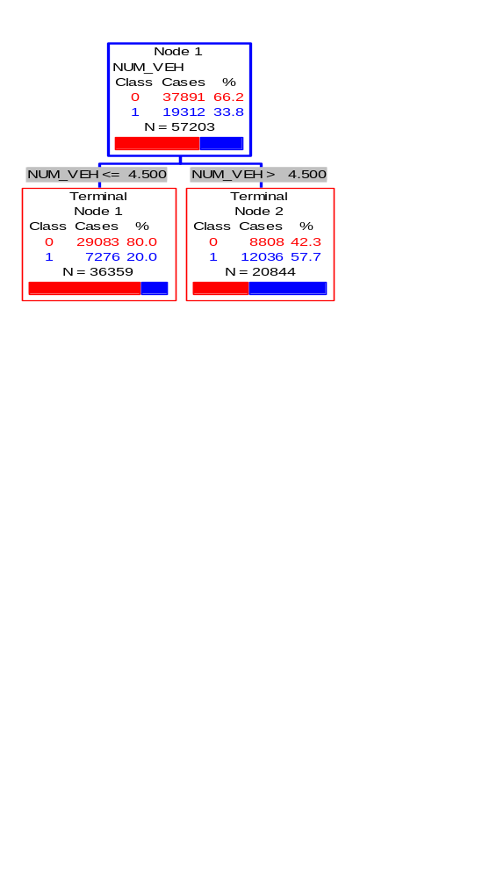
Classification Tree Example: predict likelihood of a claim
Commercial Auto Dataset
  57,000 policies
  34% claim frequency
Classification Tree using Gini splitting rule
First split:
  Policies with ≥5 vehicles have 58% claim frequency
  Else 20%
  Big increase in purity
Notes:
Copyright 2003 -- Confidential and Proprietary -- Deloitte & Touche LLP

Slide 9
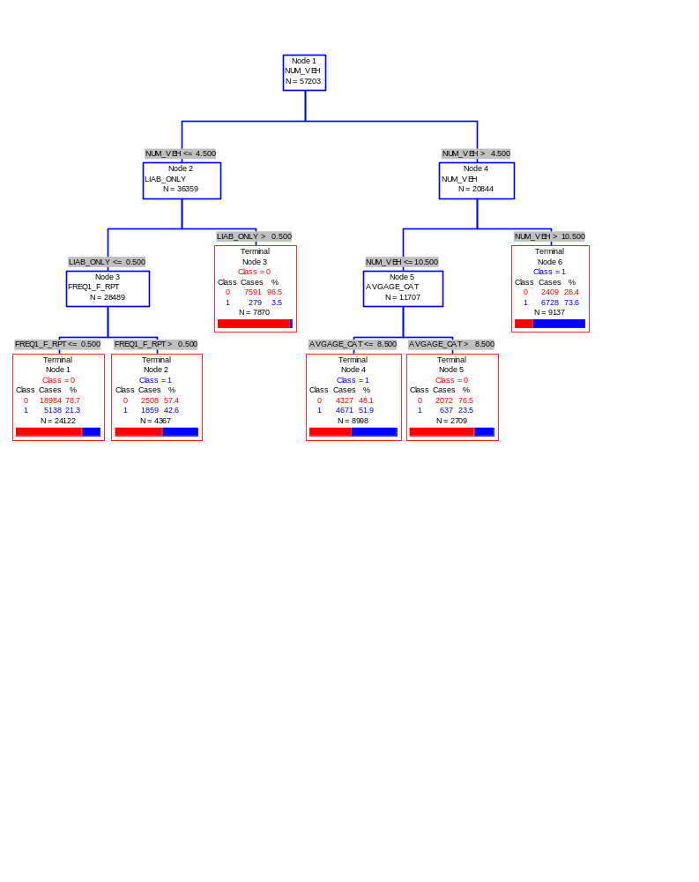
Growing the Tree
Notes:
Copyright 2003 -- Confidential and Proprietary -- Deloitte & Touche LLP

Slide 10
Observations (Shaking the Tree)
First split (# vehicles) is rather obvious
  More exposure ➔ more claims
But it confirms that CART is doing something reasonable.
  Also: the choice of splitting value 5 (not 4 or 6) is non-obvious.
  This suggests a way of optimally “binning” continuous variables into a small number of groups
Notes:
Copyright 2003 -- Confidential and Proprietary -- Deloitte & Touche LLP

Slide 11
CART and Linear Structure
Notice Right-hand side of the tree...
  CART is struggling to capture a linear relationship
  Weakness of CART
  The best CART can do is a step function approximation of a linear relationship.
Notes:
Copyright 2003 -- Confidential and Proprietary -- Deloitte & Touche LLP

Slide 12
Interactions and Rules
This tree is obviously not the best way to model this dataset.
But notice node #3
Liability-only policies with fewer than 5 vehicles have a very low claim frequency in this data.
  Could be used as an underwriting rule
  Or an interaction term in a GLM
Notes:
Copyright 2003 -- Confidential and Proprietary -- Deloitte & Touche LLP

Slide 13
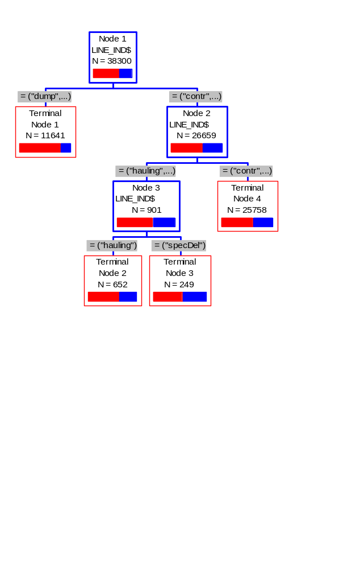
High-Dimensional Predictors
Categorical predictors: CART considers every possible subset of categories
  Nice feature
  Very handy way to group massively categorical predictors into a small # of groups
Left (fewer claims):
dump, farm, no truck
Right (more claims): contractor, hauling, food delivery, special delivery, waste, other
Notes:
Copyright 2003 -- Confidential and Proprietary -- Deloitte & Touche LLP

Slide 14
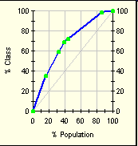
Gains Chart: Measuring Success
From left to right:
Node 6: 16% of policies, 35% of claims.
Node 4: add’l 16% of policies, 24% of claims.
Node 2: add’l 8% of policies, 10% of claims.
..etc.
  The steeper the gains chart, the stronger the model.
  Analogous to a lift curve.
  Desirable to use out-of-sample data.
Notes:
Copyright 2003 -- Confidential and Proprietary -- Deloitte & Touche LLP

Slide 15
A Little Theory
Notes:
Copyright 2003 -- Confidential and Proprietary -- Deloitte & Touche LLP

Slide 16
Splitting Rules
Select the variable value (X=t₁) that produces the greatest “separation” in the target variable.
“Separation” defined in many ways.
  Regression Trees (continuous target): use sum of squared errors.
  Classification Trees (categorical target): choice of entropy, Gini measure, “twoing” splitting rule.
Notes:
Copyright 2003 -- Confidential and Proprietary -- Deloitte & Touche LLP

Slide 17
Regression Trees
Tree-based modeling for continuous target variable
    most intuitively appropriate method for loss ratio analysis
Find split that produces greatest separation in
∑[y – E(y)]²
i.e.: find nodes with minimal within variance
    and therefore greatest between variance
    like credibility theory
Every record in a node is assigned the same yhat
    ➔ model is a step function
Notes:
Copyright 2003 -- Confidential and Proprietary -- Deloitte & Touche LLP

Slide 18
Classification Trees
Tree-based modeling for discrete target variable
In contrast with regression trees, various measures of purity are used
Common measures of purity:
    Gini, entropy, “twoing”
Intuition: an ideal retention model would produce nodes that contain either defectors only or non-defectors only
    completely pure nodes
Notes:
Copyright 2003 -- Confidential and Proprietary -- Deloitte & Touche LLP

Slide 19
More on Splitting Criteria
Gini purity of a node p(1-p)
  where p = relative frequency of defectors
Entropy of a node -Σplogp
  -[p*log(p) + (1-p)*log(1-p)]
  Max entropy/Gini when p=.5
  Min entropy/Gini when p=0 or 1
Gini might produce small but pure nodes
The “twoing” rule strikes a balance between purity and creating roughly equal-sized nodes
  Note: “twoing” is available in Salford Systems’ CART but not in the “rpart” package in R.
Notes:
Copyright 2003 -- Confidential and Proprietary -- Deloitte & Touche LLP

Slide 20
Classification Trees vs. Regression Trees
Splitting Criteria:
  Gini, Entropy, Twoing
Goodness of fit measure:
  misclassification rates
Prior probabilities and misclassification costs
  available as model “tuning parameters”
Splitting Criterion:
  sum of squared errors
Goodness of fit:
  same measure!
  sum of squared errors
No priors or misclassification costs…
  … just let it run
Notes:
Copyright 2003 -- Confidential and Proprietary -- Deloitte & Touche LLP

Slide 21
How CART Selects the Optimal Tree
Use cross-validation (CV) to select the optimal decision tree.
Built into the CART algorithm.
  Essential to the method; not an add-on
Basic idea: “grow the tree” out as far as you can…. Then “prune back”.
CV: tells you when to stop pruning.
Notes:
Copyright 2003 -- Confidential and Proprietary -- Deloitte & Touche LLP

Slide 22
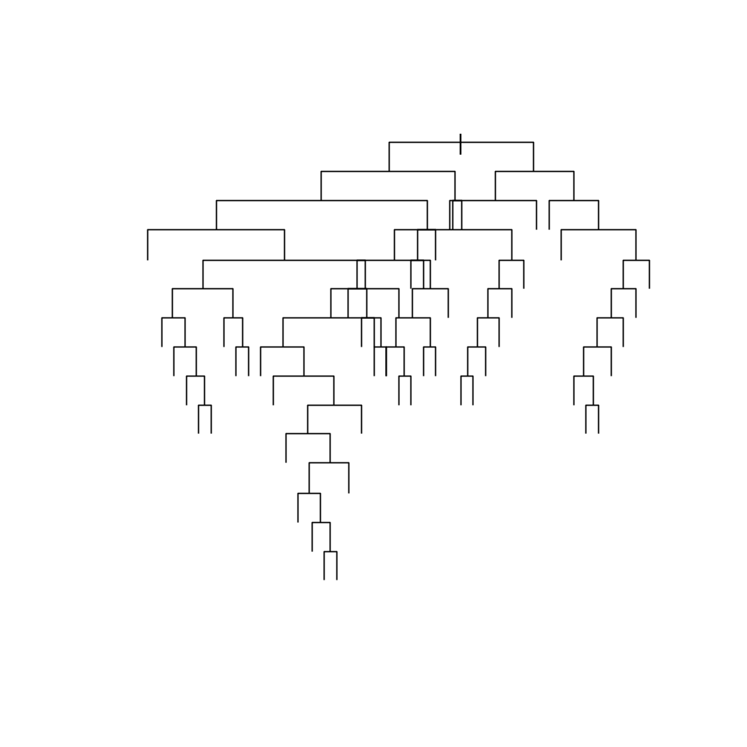
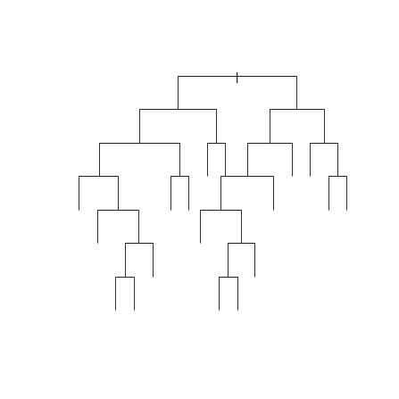
Growing & Pruning
One approach: stop growing the tree early.
    But how do you know when to stop?
CART: just grow the tree all the way out; then prune back.
    Sequentially collapse nodes that result in the smallest change in purity.
    “weakest link” pruning.
Notes:
Copyright 2003 -- Confidential and Proprietary -- Deloitte & Touche LLP

Slide 23
Finding the Right Tree
“Inside every big tree is a small, perfect tree waiting to come out.”
    --Dan Steinberg
    2004 CAS P.M. Seminar
The optimal tradeoff of bias and variance.
But how to find it??
Notes:
Copyright 2003 -- Confidential and Proprietary -- Deloitte & Touche LLP

Slide 24
Cost-Complexity Pruning
Definition: Cost-Complexity Criterion
R_{α}= MC + αL
    MC = misclassification rate
      Relative to # misclassifications in root node.
    L = # leaves (terminal nodes)
    You get a credit for lower MC.
    But you also get a penalty for more leaves.
Let T₀ be the biggest tree.
Find sub-tree of T_{α} of T₀ that minimizes R_{α}.
    Optimal trade-off of accuracy and complexity.
Notes:
Copyright 2003 -- Confidential and Proprietary -- Deloitte & Touche LLP

Slide 25
Weakest-Link Pruning
Let’s sequentially collapse nodes that result in the smallest change in purity.
This gives us a nested sequence of trees that are all sub-trees of T₀.
T₀ » T₁ » T₂ » T₃ » … » T_{k} » …
Theorem: the sub-tree T_{α} of T₀ that minimizes R_{α} is in this sequence!
    Gives us a simple strategy for finding best tree.
    Find the tree in the above sequence that minimizes CV misclassification rate.
Notes:
Copyright 2003 -- Confidential and Proprietary -- Deloitte & Touche LLP

Slide 26
What is the Optimal Size?
Note that α is a free parameter in:
R_{α}= MC + αL
1:1 correspondence betw. α and size of tree.
What value of α should we choose?
    α=0 ➔ maximum tree T₀ is best.
    α=big ➔ You never get past the root node.
    Truth lies in the middle.
Use cross-validation to select optimal α (size)
Notes:
Copyright 2003 -- Confidential and Proprietary -- Deloitte & Touche LLP

Slide 27
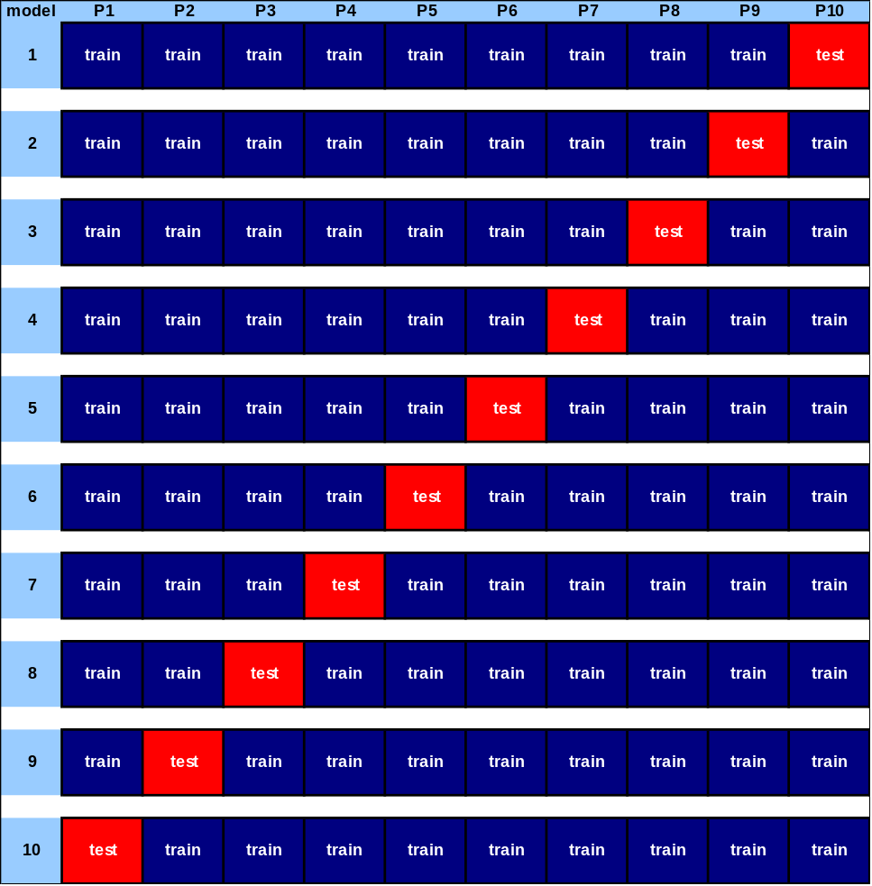
Finding α
Fit 10 trees on the “blue” data.
Test them on the “red” data.
Keep track of mis-classification rates for different values of α.
Now go back to the full dataset and choose the α-tree.
Notes:
Copyright 2003 -- Confidential and Proprietary -- Deloitte & Touche LLP

Slide 28
How to Cross-Validate
Grow the tree on all the data: T₀.
Now break the data into 10 equal-size pieces.
10 times: grow a tree on 90% of the data.
    Drop the remaining 10% (test data) down the nested trees corresponding to each value of α.
    For each α add up errors in all 10 of the test data sets.
Keep track of the α corresponding to lowest test error.
This corresponds to one of the nested trees T_{k}«T₀.
Notes:
Copyright 2003 -- Confidential and Proprietary -- Deloitte & Touche LLP

Slide 29
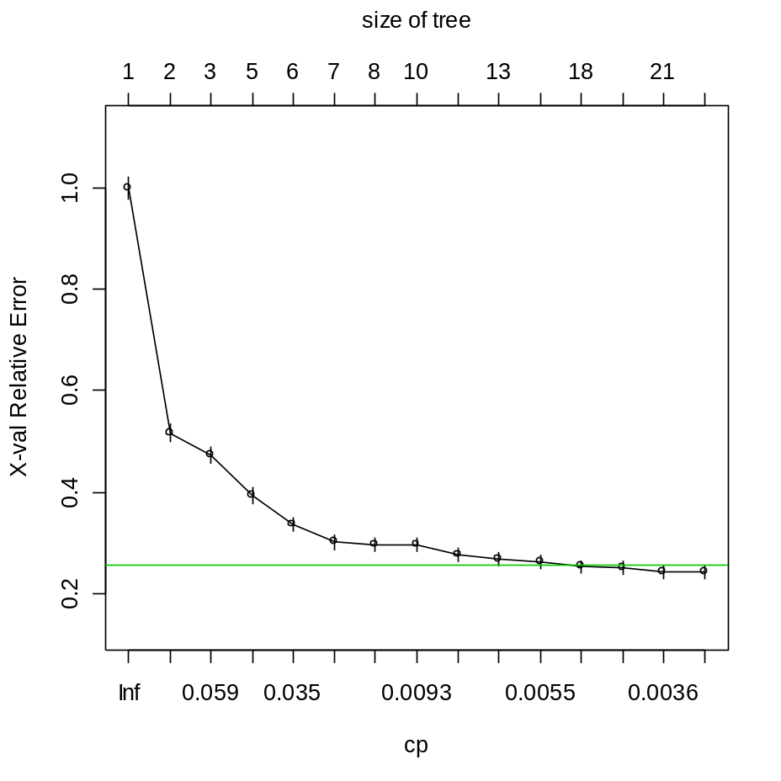
Just Right
Relative error: proportion of CV-test cases misclassified.
According to CV, the 15-node tree is nearly optimal.
    In summary: grow the tree all the way out.
    Then weakest-link prune back to the 15 node tree.
Notes:
Copyright 2003 -- Confidential and Proprietary -- Deloitte & Touche LLP

Slide 30
CART in Practice
Notes:
Copyright 2003 -- Confidential and Proprietary -- Deloitte & Touche LLP

Slide 31
CART advantages
Nonparametric (no probabilistic assumptions)
Automatically performs variable selection
Uses any combination of continuous/discrete variables
  Very nice feature: ability to automatically bin massively categorical variables into a few categories.
    zip code, business class, make/model…
Discovers “interactions” among variables
  Good for “rules” search
  Hybrid GLM-CART models
Notes:
Copyright 2003 -- Confidential and Proprietary -- Deloitte & Touche LLP

Slide 32
CART advantages
CART handles missing values automatically
    Using “surrogate splits”
Invariant to monotonic transformations of predictive variable
Not sensitive to outliers in predictive variables
  Unlike regression
Great way to explore, visualize data
Notes:
Copyright 2003 -- Confidential and Proprietary -- Deloitte & Touche LLP

Slide 33
CART Disadvantages
The model is a step function, not a continuous score
    So if a tree has 10 nodes, yhat can only take on 10 possible values.
    MARS improves this.
Might take a large tree to get good lift
    But then hard to interpret
    Data gets chopped thinner at each split
Instability of model structure
    Correlated variables ➔ random data fluctuations could result in entirely different trees.
CART does a poor job of modeling linear structure
Notes:
Copyright 2003 -- Confidential and Proprietary -- Deloitte & Touche LLP

Slide 34
Uses of CART
Building predictive models
  Alternative to GLMs, neural nets, etc
Exploratory Data Analysis
  Breiman et al: a different view of the data.
  You can build a tree on nearly any data set with minimal data preparation.
  Which variables are selected first?
  Interactions among variables
  Take note of cases where CART keeps re-splitting the same variable (suggests linear relationship)
Variable Selection
  CART can rank variables
  Alternative to stepwise regression
Notes:
Copyright 2003 -- Confidential and Proprietary -- Deloitte & Touche LLP

Slide 35
Case Study:
Spam e-mail Detection
Compare CART with:
Neural Nets
MARS
Logistic Regression
Ordinary Least Squares
Notes:
Copyright 2003 -- Confidential and Proprietary -- Deloitte & Touche LLP

Slide 36
The Data
Goal: build a model to predict whether an incoming email is spam.
    Analogous to insurance fraud detection
About 21,000 data points, each representing an email message sent to an HP scientist.
Binary target variable
    1 = the message was spam: 8%
    0 = the message was not spam 92%
Predictive variables created based on frequencies of various words & characters.
Notes:
Copyright 2003 -- Confidential and Proprietary -- Deloitte & Touche LLP

Slide 37
The Predictive Variables
57 variables created
    Frequency of “George” (the scientist’s first name)
    Frequency of “!”, “$”, etc.
    Frequency of long strings of capital letters
    Frequency of “receive”, “free”, “credit”….
    Etc
Variables creation required insight that (as yet) can’t be automated.
    Analogous to the insurance variables an insightful actuary or underwriter can create.
Notes:
Copyright 2003 -- Confidential and Proprietary -- Deloitte & Touche LLP

Slide 38
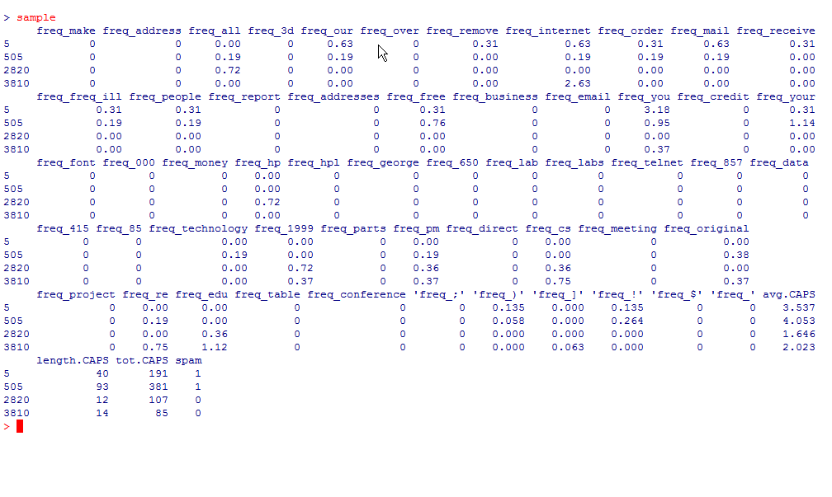
Sample Data Points
Notes:
Copyright 2003 -- Confidential and Proprietary -- Deloitte & Touche LLP

Slide 39
Methodology
Divide data 60%-40% into train-test.
Use multiple techniques to fit models on train data.
Apply the models to the test data.
Compare their power using gains charts.
Notes:
Copyright 2003 -- Confidential and Proprietary -- Deloitte & Touche LLP

Slide 40
Software
R statistical computing environment
  Classification or Regression trees can be fit using the “rpart” package written by Therneau and Atkinson.
  Designed to follow the Breiman et al approach closely.
  http://www.r-project.org/
Notes:
Copyright 2003 -- Confidential and Proprietary -- Deloitte & Touche LLP

Slide 41
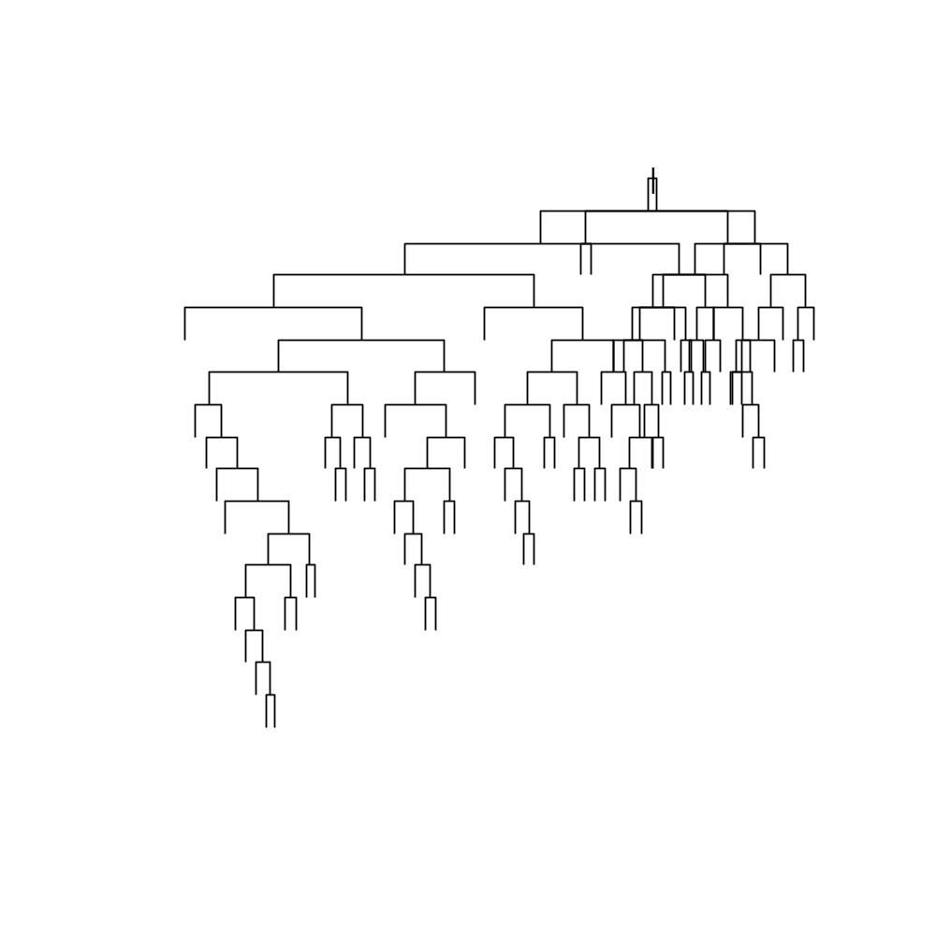
Un-pruned Tree
Just let CART keep splitting as long as it can.
Too big.
  Messy
  More importantly: this tree over-fits the data
Use Cross-Validation (on the train data) to prune back.
  Select the optimal sub-tree.
Notes:
Copyright 2003 -- Confidential and Proprietary -- Deloitte & Touche LLP

Slide 42
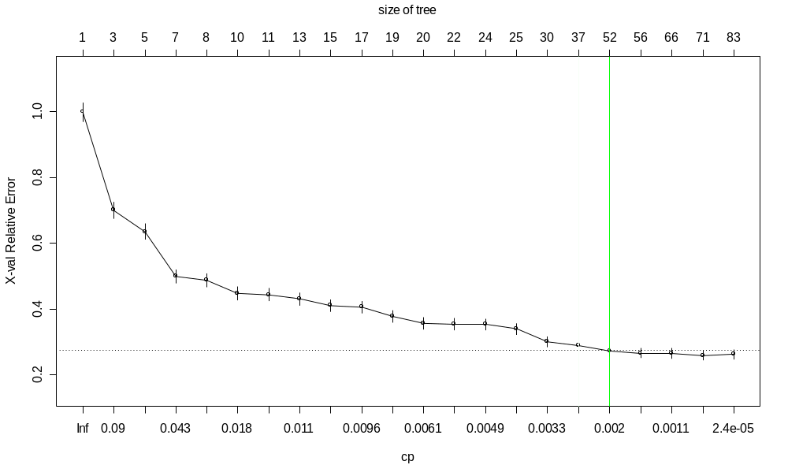
Pruning Back
Plot cross-validated error rate vs. size of tree
  Note: error can actually increase if the tree is too big (over-fit)
Looks like the ≈ optimal tree has 52 nodes
So prune the tree back to 52 nodes
Notes:
Copyright 2003 -- Confidential and Proprietary -- Deloitte & Touche LLP

Slide 43
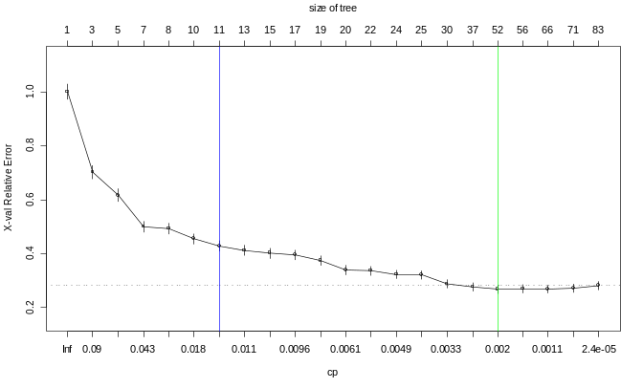
Pruned Tree #1
The pruned tree is still pretty big.
Can we get away with pruning the tree back even further?
Let’s be radical and prune way back to a tree we actually wouldn’t mind looking at.
Notes:
Copyright 2003 -- Confidential and Proprietary -- Deloitte & Touche LLP

Slide 44
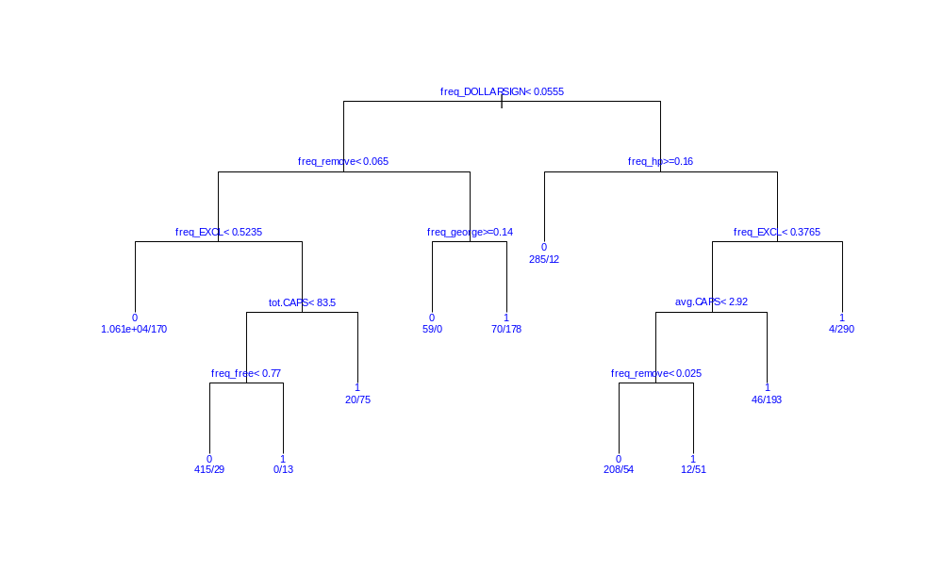
Pruned Tree #2
Suggests rule:
Many “$” signs, caps, and “!” and few instances of company name (“HP”) ➔ spam!
Notes:
Copyright 2003 -- Confidential and Proprietary -- Deloitte & Touche LLP

Slide 45
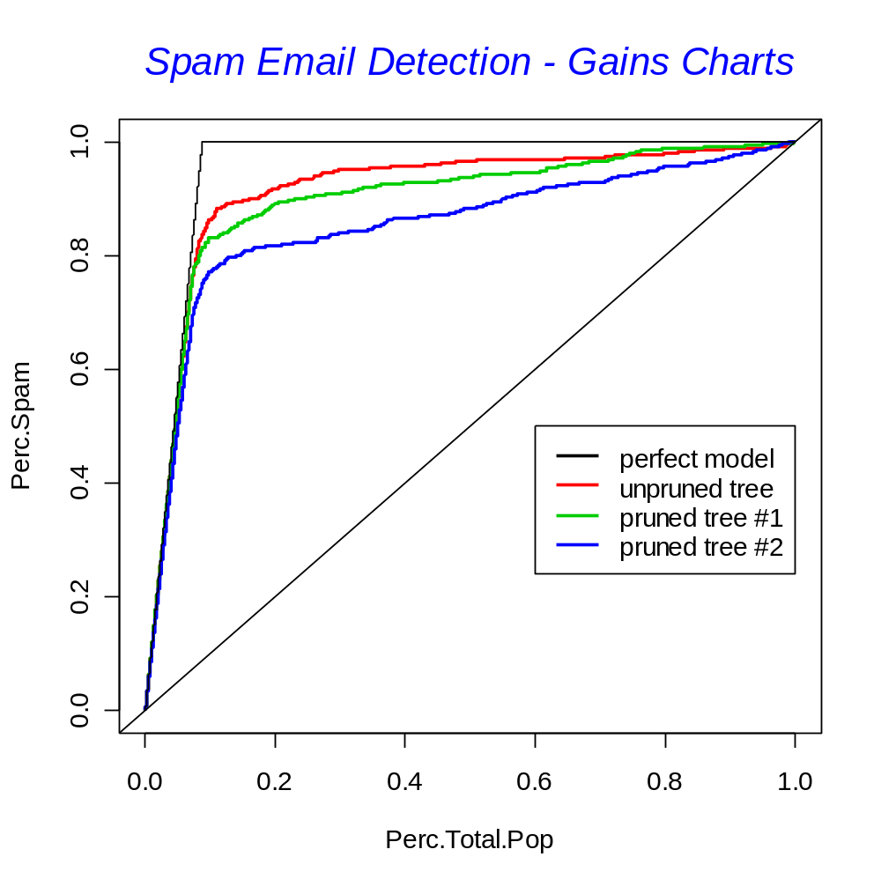
CART Gains Chart
How do the three trees compare?
Use gains chart on test data.
  Outer black line: the best one could do
  45º line: monkey throwing darts
The bigger trees are about equally good in catching 80% of the spam.
We do lose something with the simpler tree.
Notes:
Copyright 2003 -- Confidential and Proprietary -- Deloitte & Touche LLP

Slide 46
Other Models
Fit a purely additive MARS model to the data.
    No interactions among basis functions
Fit a neural network with 3 hidden nodes.
Fit a logistic regression (GLM).
    Using the 20 strongest variables
Fit an ordinary multiple regression.
    A statistical sin: the target is binary, not normal
Notes:
Copyright 2003 -- Confidential and Proprietary -- Deloitte & Touche LLP

Slide 47
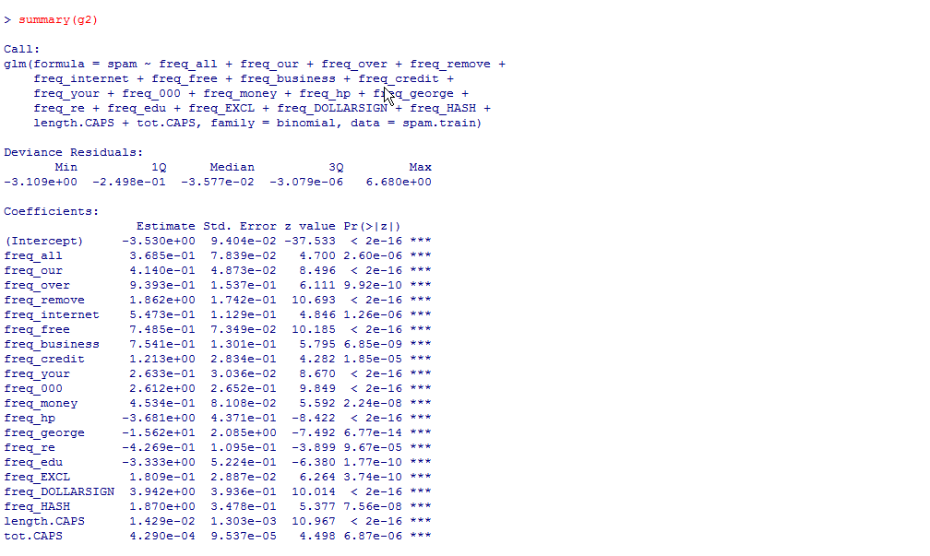
GLM model
Logistic regression run on 20 of the most powerful predictive variables
Notes:
Copyright 2003 -- Confidential and Proprietary -- Deloitte & Touche LLP

Slide 48
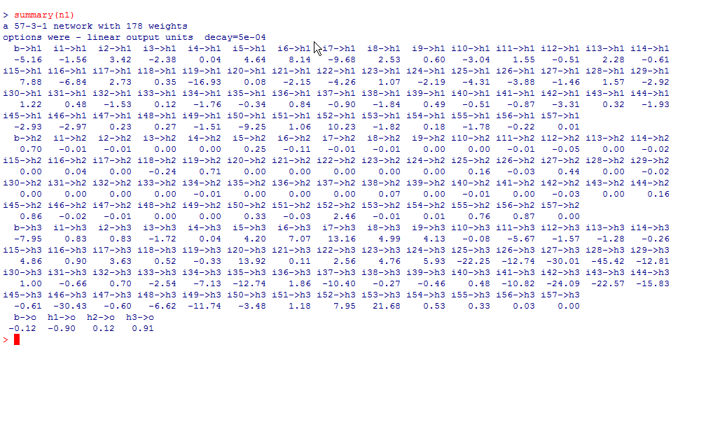
Neural Net Weights
Notes:
Copyright 2003 -- Confidential and Proprietary -- Deloitte & Touche LLP

Slide 49
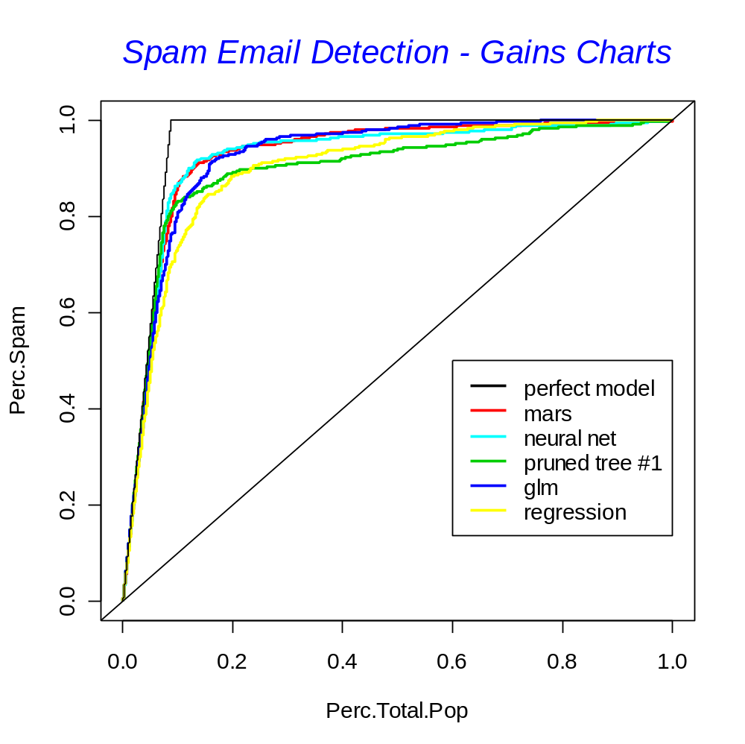
Comparison of Techniques
All techniques add value.
  MARS/NNET beats GLM.
  But note: we used all variables for MARS/NNET; only 20 for GLM.
  GLM beats CART.
In real life we’d probably use the GLM model but refer to the tree for “rules” and intuition.
Notes:
Copyright 2003 -- Confidential and Proprietary -- Deloitte & Touche LLP

Slide 50
Parting Shot: Hybrid GLM model
We can use the simple decision tree (#3) to motivate the creation of two ‘interaction’ terms:
  “Goodnode”:
    (freq_$ < .0565) & (freq_remove < .065) & (freq_! <.524)
  “Badnode”:
    (freq_$ > .0565) & (freq_hp <.16) & (freq_! > .375)
We read these off tree (#3)
Code them as {0,1} dummy variables
Include in GLM model
  At the same time, remove terms no longer significant.
Notes:
Copyright 2003 -- Confidential and Proprietary -- Deloitte & Touche LLP

Slide 51
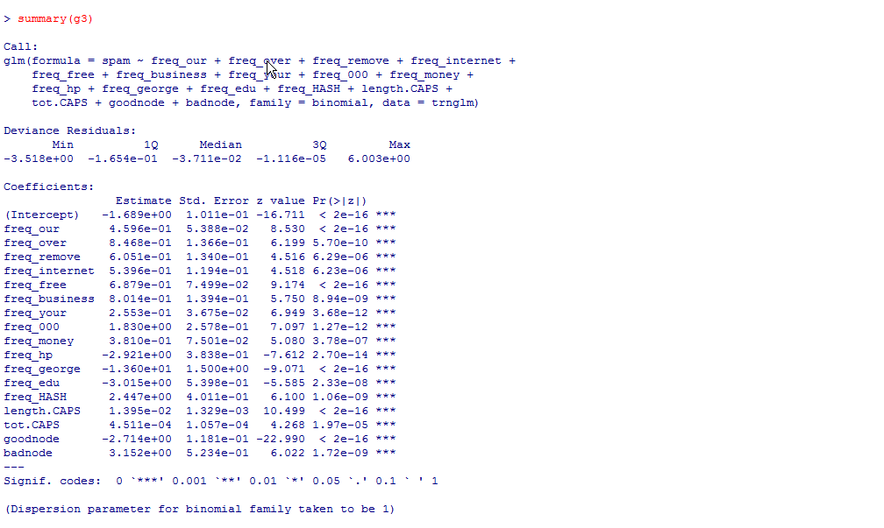
Hybrid GLM model
The Goodnode and Badnode indicators are highly significant.
Note that we also removed 5 variables that were in the original GLM
Notes:
Copyright 2003 -- Confidential and Proprietary -- Deloitte & Touche LLP

Slide 52
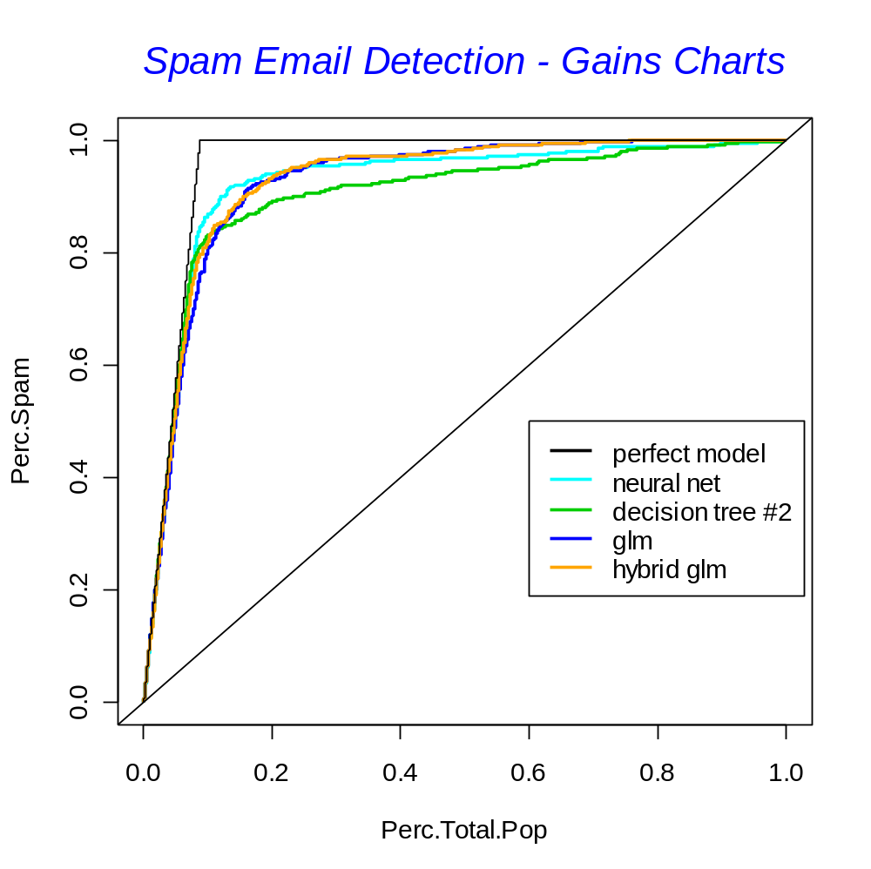
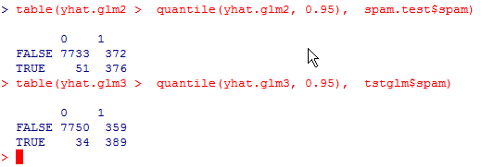
Hybrid Model Result
Slight improvement over the original GLM.
  See gains chart
  See confusion matrix
Improvement not huge in this particular model…
… but proves the concept
Notes:
Copyright 2003 -- Confidential and Proprietary -- Deloitte & Touche LLP

Slide 53
Concluding Thoughts
In many cases, CART will likely under-perform tried-and-true techniques like GLM.
    Poor at handling linear structure
    Data gets chopped thinner at each split
BUT: is highly intuitive and a great way to:
  Get a feel for your data
  Select variables
  Search for interactions
  Search for “rules”
  Bin variables
Notes:
Copyright 2003 -- Confidential and Proprietary -- Deloitte & Touche LLP

Slide 54
More Philosophy
“Binary Trees give an interesting and often illuminating way of looking at the data in classification or regression problems. They should not be used to the exclusion of other methods. We do not claim that they are always better. They do add a flexible nonparametric tool to the data analyst’s arsenal.” --Breiman, Friedman, Olshen, Stone
Notes:
Copyright 2003 -- Confidential and Proprietary -- Deloitte & Touche LLP

